Slide 1
Sodium-borate (SB) vs. Tris-Borate-EDTA (TBE) for gel electrophoresis of DNA
By using SB for both gel and running buffer, we can:
1) Run gels faster & at higher-throughputs
2) Get better quality gels
-- Sharper bands
-- Fully separated bands in 100-bp DNA ladder
-- Better sample band separation & size estimates
-- Harder to overload with DNA
3) Save $ (pricing as of 21 April 2020)
-- TBE (1/2X) = $1.10/L (from 10X Liquid Concentrate 4L, VWR)
-- SB (1X) = $0.20/L (from powders/pellets, Sigma-Aldrich)

Slide 2
Presentation overview: 30 slides
>> PCR product: 543 bp Alu (Owl monkey).
-- Compare TBE (Tris-Borate-EDTA) & SB (sodium borate) at various voltages & running times
-- show whole gels;
-- compare leaching effects of EtBr (ethidium bromide);
-- compare DNA overloading potential of TBE vs. SB;
-- focus on middle 2 rows in gels;
-- Remelting of SB gels.
-- SB gels at excessive voltage.
-- Recap TBE vs. best SB parameters.
-- High-throughput gels.
-- Summary slides.

Slide 3
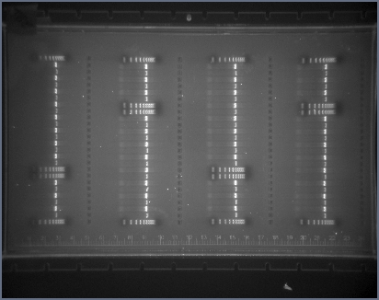
TBE (new gel): 45 min @ 200 V (standard run conditions)
5 ul
1.5 ul
300 bp
200 bp
EtBr
leaching
-- Band cupping & overloading
-- Streaking and smearing of DNA in lanes
-- Poor separation at high MW
Gel runs

Slide 4
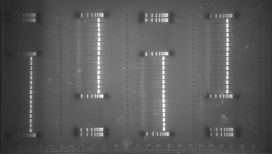
TBE (new gel): 15 min @ 600 V
5 ul
300 bp
200 bp
EtBr
leaching
-- Similar results, but somewhat more pronounced @ 600 V
Gel runs

Slide 5
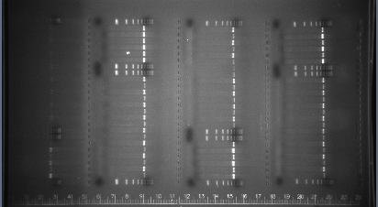
Sodium-borate: 15 min @ 600 V
6 ul
12 ul
6 ul
2 ul
EtBr leaching
Gel runs
-- Bands are straight
-- Minimal streaking
-- Good separation even at high MW

Slide 6
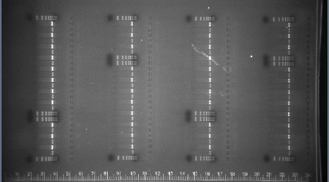
Sodium-borate (used 1X): 10 min @ 600 V (“used” = re-melted gel, no extra EtBr added)
Gel runs
6 ul
200 bp
2 ul
100 bp
EtBr
leaching
-- Similar results to 600 V for 15 min, except:
-- EtBr concentration ok... due to reduced run time and migration of EtBR from used buffer into gel front.
-- High MW bands not as well separated

Slide 7
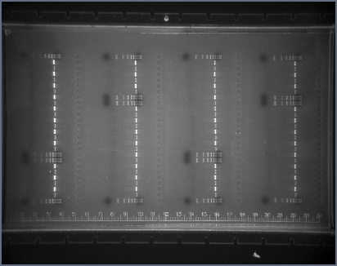
Sodium-borate (used 1X): 15 min @ 500 V
6 ul
200 bp
2 ul
100 bp
EtBr
leaching
Gel runs
-- Similar results to 600 V for 10 min, except here the High MW bands are well separated

Slide 8
Ethidium Bromide leaching
1) Ethidium bromide migrates in the opposite direction of the DNA; thus, the “front” of the gel can become devoid of ethidium bromide... causing DNA bands to ‘vanish’.
2) Primarily affects leading row of DNA samples
3) To Reduce effect when taking photos of leached gels:
a) move gel section away from edge of UV illuminator
b) crop photo, click on “transform”, and
adjust “gamma” slide

Slide 9
Comparison of TBE & SB (time & voltage)
45 min
200V
200 bp
15 min
600V
TBE
200 bp
SB
15 min
600V
Bands are weak due to ‘leading edge’ effect.
300 bp
200 bp
10 min
600V
100 bp
Bands are stronger; less time for migration.
15 min
500V
Bands are stronger; more time, but lower voltage.
100 bp

Slide 10
Overloading potential of TBE vs. SB gels
TBE (new): 45 min @ 200V
Sodium-borate (new): 15 min @ 600 V
ul DNA
ul DNA
5
1.5
6
12
Note that the SB gel gave much cleaner results, with crisper DNA bands... even with more DNA loaded in each lane.

Slide 11
TBE vs. SB: Middle 2 rows of gels
TBE (new)
45 min
200V
SB (new)
15 min
600V
SB (used 1X)
10 min
600V
SB (used 1X)
15 min
500V
Again, SB gels gave much cleaner results, with crisper DNA bands... even with more DNA loaded in each lane.

Slide 12
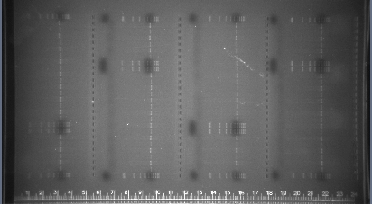
Remelting of SB gels: full gel
Sodium-borate (remelted 3 times): 15 min @ 600V – no issues

Slide 13
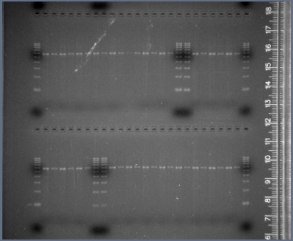
Closer look at Remelting SB gels: 1st half gel
Sodium-borate (remelted 3 times): 15 min @ 600V – no issues

Slide 14
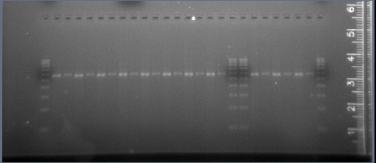
Closer Look at Remelting SB gels: Leading edge of gel
100 bp
Sodium-borate (remelted 3 times): 15 min @ 600 V – no issues
Note: EtBr leached into tray buffer from prior 3 gels apparently
“restained” the leading row of samples

Slide 15
High Voltage & SB Gels
Sodium-borate (used 1X): 10 min @ 600 V; minimal increase in mA & ºC over run
Gel runs
T- 0 min: 164 mA; 98 W; 25ºC
T-10 min: 260 mA; 156 W; 28ºC (mA increased by <100; temperature increased 3ºC)

Slide 16
Excessive Voltage & SB Gels
750 V (10 min)
– ↑’d 200 mA
– Temp ↑’d 12ºC
>> Gel did not melt, but mA and temperature increases were excessive.
900 V (10 min)
– 810 V by 5 min
– 700 V by 10 min
– ↑’d 200 mA
– Temp ↑’d 14ºC
>> Parts of gel melted (see wavy bands in circle) and the change in gel consistency even affected the run voltage.
Gel runs

Slide 17
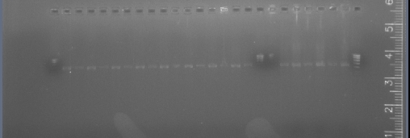
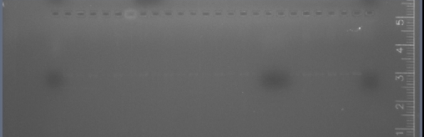
Excessive voltage & EtBr leaching in SB gels
750V
10 min
Moderately excessive voltage (750 V) caused rapid leaching of EtBr at gel front,
but just enough dye remained to still weakly stain the DNA bands.
900 initial-V
Extreme excessive voltage (900 V) caused complete leaching of EtBr at gel front,
such that the DNA bands (molecular ladders and samples) are not visibly stained.

Slide 18
Recap
-- Next 2 slides show results for
standard TBE vs. best SB parameters
-- In SB, DNA bands are still much sharper (more compact), and lanes show much less smearing.
Note: Remember to make BOTH the gel
and the running buffer from
1X SB media.

Slide 19
Gels for TBE vs. SB under each buffer’s “Best” run conditions
TBE (new)
45 min
200V
Sodium-borate (used 1X)
15 min
500V

Slide 20
Full 25-cm SB gel: 4 rows; 26 wells/row
Sodium-borate (used 1X)
15 min
500V
Gel runs

Slide 21
High-throughput with SB gels 10 combs in 25-cm gel (vs. 4)
300 bp
500 bp
300 bp
500 bp
½ Pop Plate #3
Pop Plate #2
Population Plate #1
Gel runs
Sodium-borate (new): 7 min @ 600 V
-- With TBE, no more than 4 combs could be used in a 25-cm gel; thus, each Population plate required 1 full gel.
-- Note: Gel was cut in ½ lengthwise for display purposes.

Slide 22
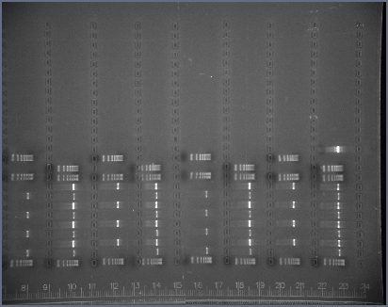
Close-up view of High Throughput with SB gels
Sodium-borate (new)
7 min @ 600V
10 combs in 25-cm gel (vs. 4)
Note:
Band resolution would be even
better if run @ 300-400 V for ~15’.
Gel runs
Pop Plate #2
Pop Plate #1
300 bp
500 bp
300 bp
500 bp

Slide 23
Sodium-borate (SB) Limitations
1) No advantages to 1/2X SB (unlike TBE)
-- runs significantly more slowly
-- gels don’t look as good as with 1X SB
-- This is because SB was specifically designed for running DNA. By contrast, 1X TBE was the recipe used for protein electrophoresis and turned out to be 2X stronger than needed for DNA electrophoresis.
2) Voltage for 25 cm gels:
-- 500 V (20 V/cm gel): quality is excellent.
-- 600 V (24 V/cm gel): quality is still good.
-- EtBr leaches from leading row by 15 min @ 600V.
-- 700 V (28 V/cm gel): quality deteriorates.
-- 900 V (36 V/cm gel): gels melt.
3) Gels <25 cm long?:
-- not tested here.
-- Brody & Kern: ran @ ≤35 V/cm for 10 cm gels (1.2%).

Slide 24
Cloning from SB gels?
Brody & Kern (Biotechniques 36:214-216)
“We have performed gel extraction of restriction-
digested plasmid DNA from SB gels and successfully
subcloned the fragment.”
‘Faster Better Media’ website FAQ’s:
Q: “Will SB interfere with my DNA (sub-cloning, w/kits, etc.)?
A: “NO. We have used commonly used commercially available
kits to extract DNA and clone with SB. Your DNA might even
be happier in a cooler medium such as SB.”
Genomics Core (LSU, Dept. Biol. Sci.):
→ We have had the same results.

Slide 25
Advantages of SB running media
By using SB, we can:
1) Run gels at least 3X faster than with TBE
-- 15 min @ 500 V for extensive band separation
2) High-throughput of 2.5 pop plates/gel
-- 7 min @ 600 V for filled/empty site recognition
3) Get better quality gels
-- Sharper bands
-- Fully separated bands in 100-bp DNA ladder
-- Better sample band separation & size estimates
-- Harder to overload with DNA
4) Save $ (pricing as of 21 April 2020)
-- TBE (1/2X) = $1.10/L (from 10X Liquid Concentrate 4L, VWR)
-- SB (1X) = $0.20/L (from powders/pellets, Sigma-Aldrich)

Slide 26
Recommendations by Brody & Kern
→ BioTechniques 36:214-216 (February 2004). Sodium boric acid:
a Tris-free, cooler conductive medium for DNA electrophoresis.
→ Analytical Biochemistry 333 (2004) 1–13. History and principles of
conductive media for standard DNA electrophoresis.
→ http://www.fasterbettermedia.com/
1) Standard applications:
-- 10 mM sodium boric acid (SB)
2) Small DNA or RNA fragments (1 bp resolution):
-- 1 mM lithium boric acid
3) High resolution of large DNA fragments (>3 kb):
-- 5 mM lithium acetate

Slide 27
Sources for SB media
“Powder”: 1X @ $0.20/L
Make 20X solutions in Glass bottles from either:
A) 5 mM disodium borate decahydrate; or,
B) 10 mM sodium hydroxide pH’d with borate, as follows:
-> 8 g NaOH pellets ($70/500g, Sigma-Aldrich)
-> 36.76 g H₃BO₃ ($78/kg, Sigma-Aldrich)
-> Stir & heat in 800 ml Nanopure water;
cool, qs to 1000 ml (~ pH 8.5 @ RT).
-> 1 kg H₃BO₃ and 217 g NaOH are sufficient to make 544 L of 1X SB for ~$0.2/liter.
-> Solution must be heated to dissolve the boric acid.
-> If your usage is high, SB can be prepared as 40X solutions; however, precipitates will form within
a few weeks even in glass bottles; in that case, reheat to dissolve prior to making 1X dilution.
-> By contrast, 20X solutions do not precipitate in glass bottles stored at room temperature.
2) 20X SB™: Sodium boric acid conductive medium
from Faster Better Media. – 21Apr2020 prices, shipping is extra.
-- 1X @ $4.15/L: $83, 1 liter bottle.
-- 1X @ $3.05/L: $244, 4 liter box, spigot.
-- 1X @ $2.28/L: $455, 10 liter box, spigot.
-- 1X @ $2.04/L: $816, 20 liter box, spigot.

Slide 28
Finis

